Slide 1
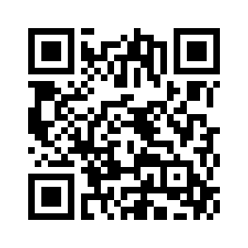
Sensors and Actuators
COMSM4111 Robotic Systems
Before we start: Please go to www.menti.com and use code: 94 75 78
Anonymous Feedback form:
https://forms.gle/PyQQy2mwzyATFmJW6
Padlet board (questions & comments):
http://padlet.com/paul_odowd1/1lhoodwv2fuc
Delivered by:
Martin Garrad m.garrad@bristol.ac.uk
Notes:
This lecture is all about Time

Slide 2
Lab Sessions / Sheets
Week 1
Week 2
Week 3
Week 4
Week 5
Week 6
Week 7
Meet the Romi
Millis()
Encoders
PID
Line Following
Finite State Machine
Motors
Time & Speed
Kinematics
Lectures
Intro
Sensors & Actuators
Feedback Control 2
Kinematics
System
Architectures
Path Planning
Experimental Robotics
Micro-controllers
Feedback Control 1
Probabilistic Robotics
PID Drop-In
A
Searching & Mapping
Sensor Fusion
Toward
Assessment 2
Assessment Op 1
Assessment Op 2
Assessment Op 3

Slide 3
Sensors and Actuators
Lecture Outline
Actuators
What actuators does the Romi have?
How do I control the motors on the Romi?
Sensors
How do I talk to a sensor?
Filtering and Calibration

Slide 4
Sensors and Actuators
Lecture Outline
Actuators
What actuators does the Romi have?
How do I control the motors on the Romi?
Sensors
How do I talk to a sensor?
Filtering and Calibration

Slide 5
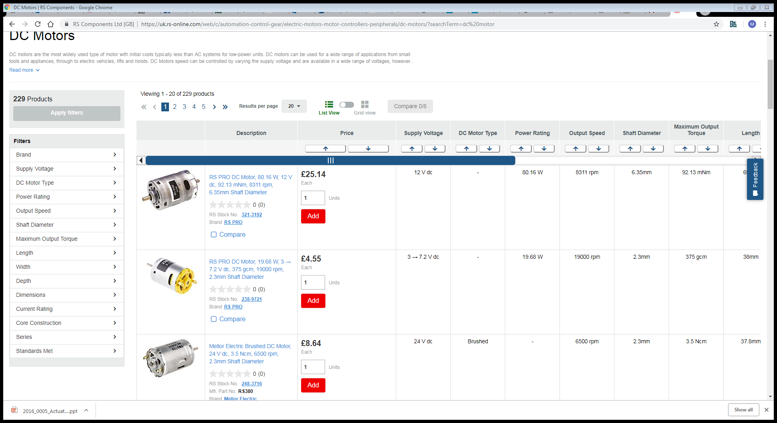
Actuators
The Romi has two brushed DC gear motors.

Slide 6
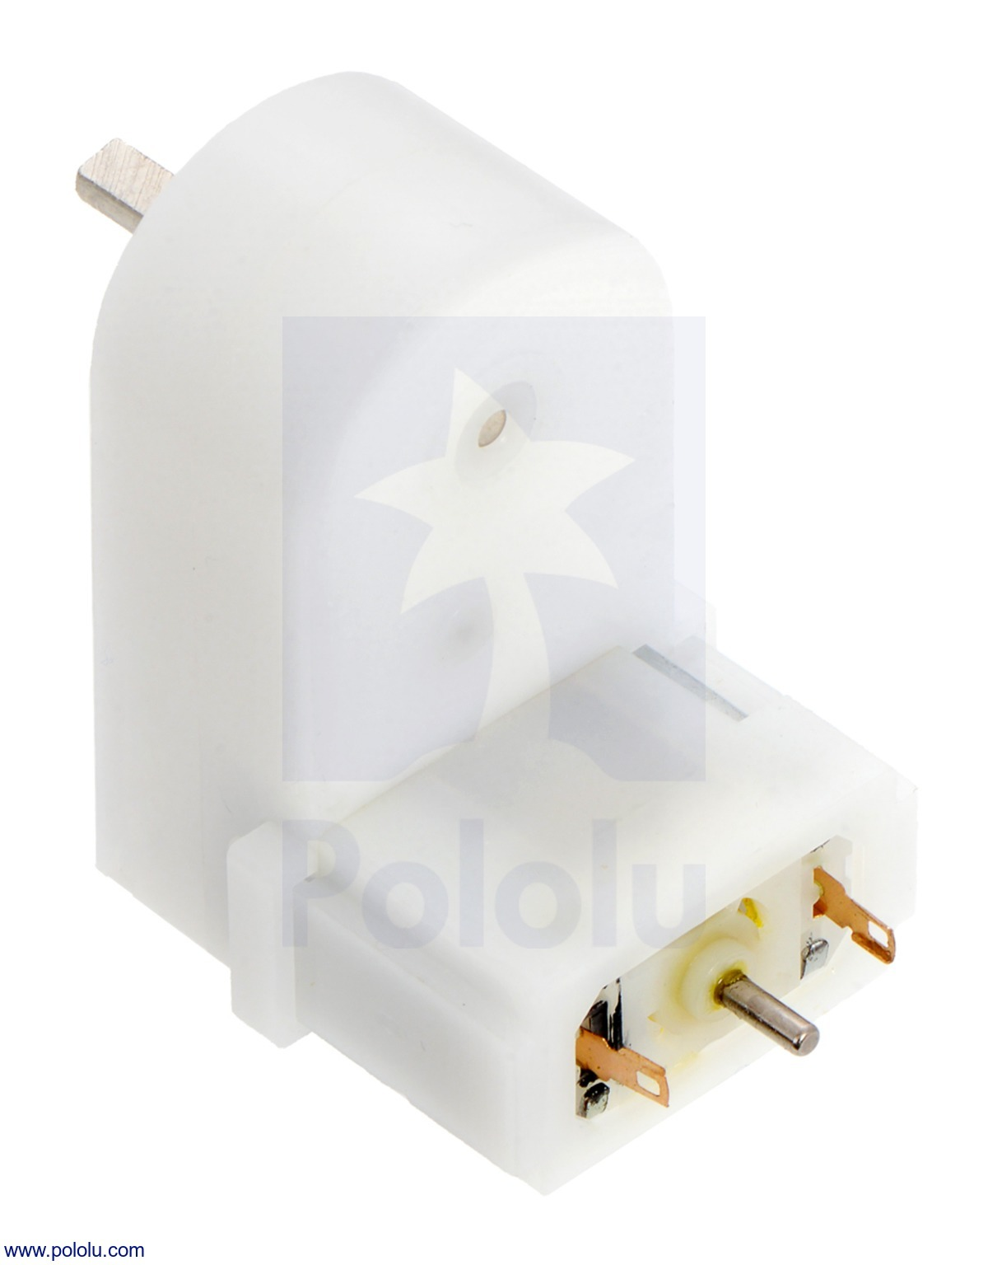
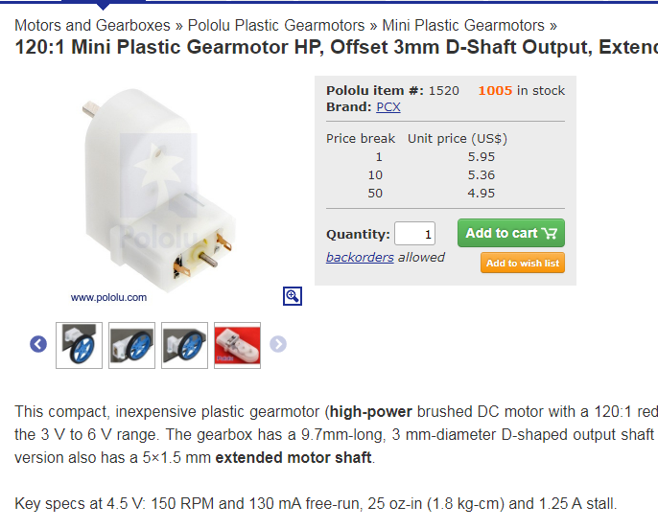
Actuators
The Romi has two brushed DC gear motors.

Slide 7
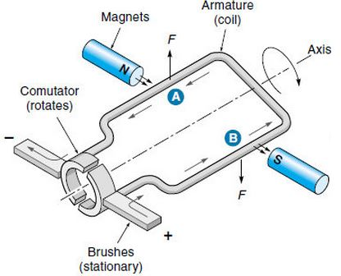
Actuators
The Romi has two brushed DC gear motors.
[Derive equations here]

Slide 8
Actuators
No Load Speed
Speed
Nominal Point
Continuous
Intermittent
Stall Torque
Torque

Slide 9
Actuators
Speed
Torque

Slide 10
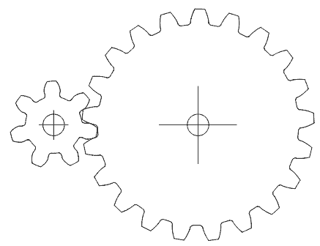
Actuators
Output – 21 teeth
Input – 7 teeth
Gear Ratio = G = N_{output} / N_{input}
ω _{output} = ω _{input} / G
τ _{output} = τ _{input} x G

Slide 11
Actuators
No Load Speed
No Load Speed
Speed
Nominal Point
Speed
Nominal Point
Stall Torque
Stall Torque
Continuous
Intermittent
Continuous
Intermittent
Torque
Torque

Slide 12
Actuators
No Load Speed
No Load Speed
Speed
Nominal Point
Speed
Nominal Point
Stall Torque
Stall Torque
Continuous
Intermittent
Continuous
Intermittent
Torque
Torque
Comprehension check: go to www.menti.com and input code: 74 70 59

Slide 13
Sensors and Actuators
Lecture Outline
Actuators
What actuators does the Romi have?
How do I control the motors on the Romi?
Sensors
How do I talk to a sensor?
Filtering and Calibration

Slide 14
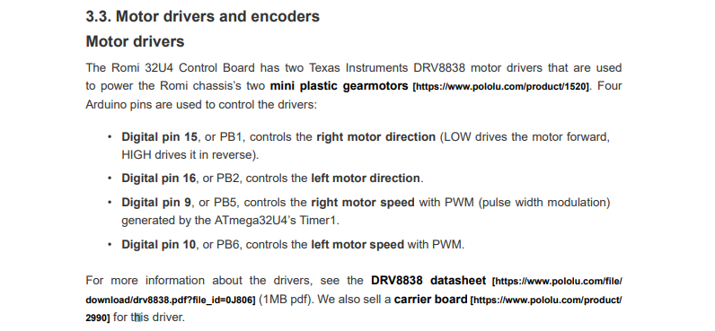
Actuators

Slide 15
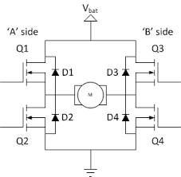
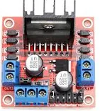
Actuators
H-Bridge

Slide 16
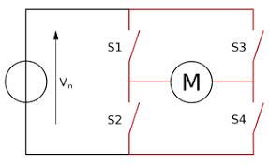
Actuators

Slide 17
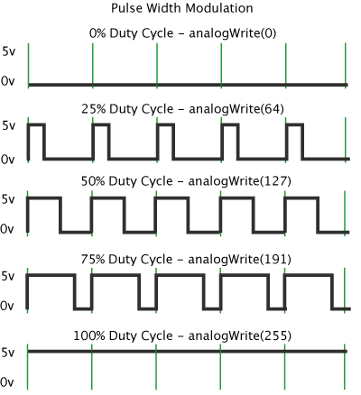
Actuators
Q: How do we control speed?
Comprehension check: Go to menti.com and use the code: 95 66 06

Slide 18
Sensors and Actuators
Lecture Outline
Actuators
What actuators does the Romi have?
How do I control the motors on the Romi?
Sensors
How do I talk to a sensor?
Filtering and Calibration

Slide 19
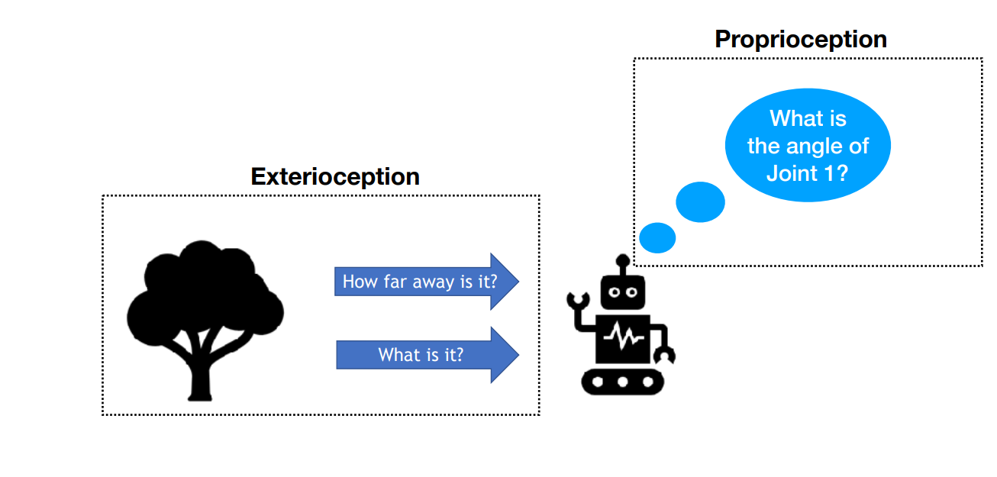
Sensing

Slide 20
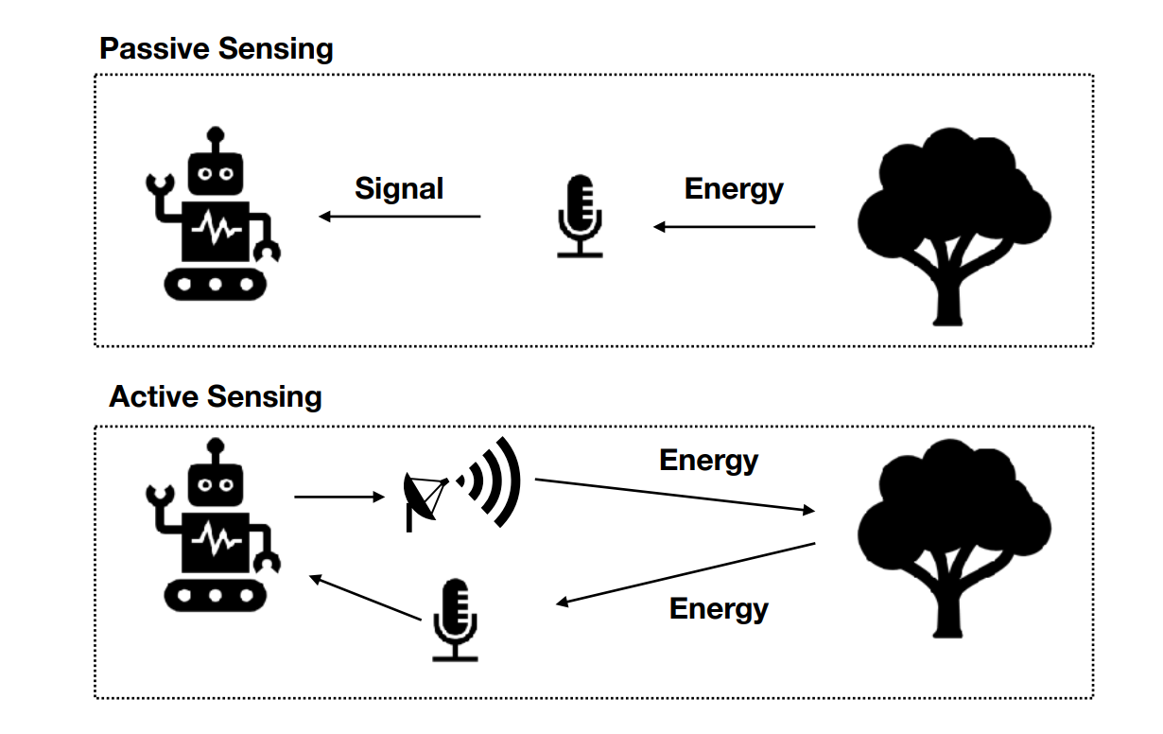
Sensing

Slide 21
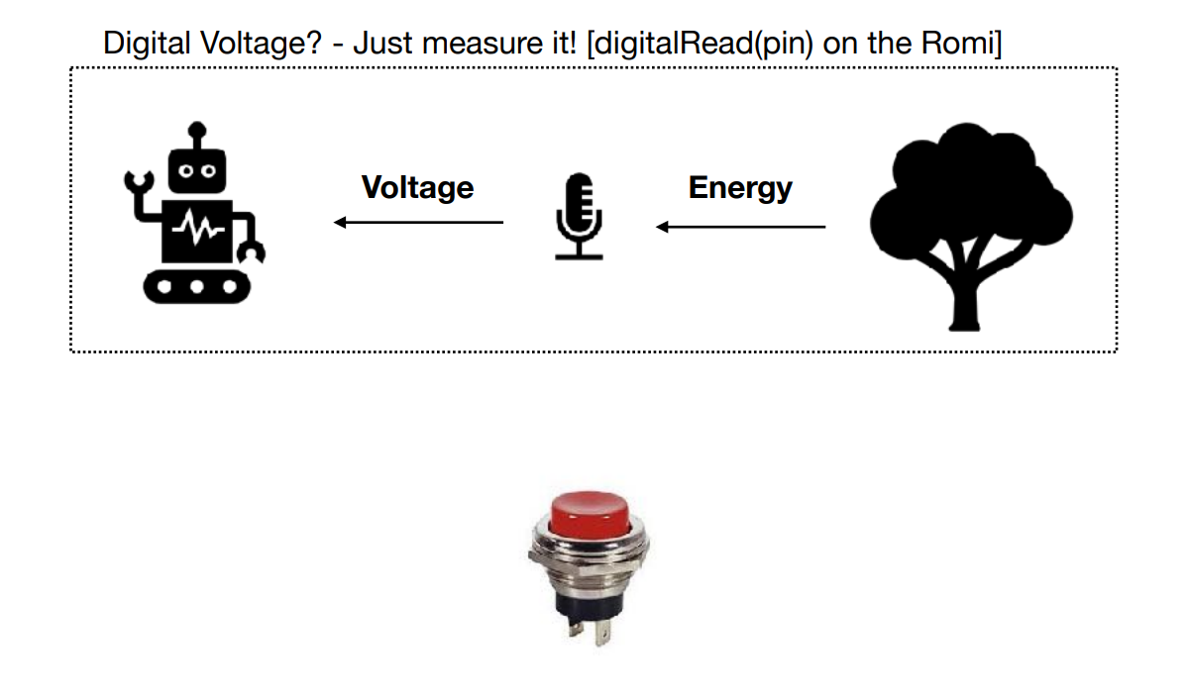
Sensing

Slide 22
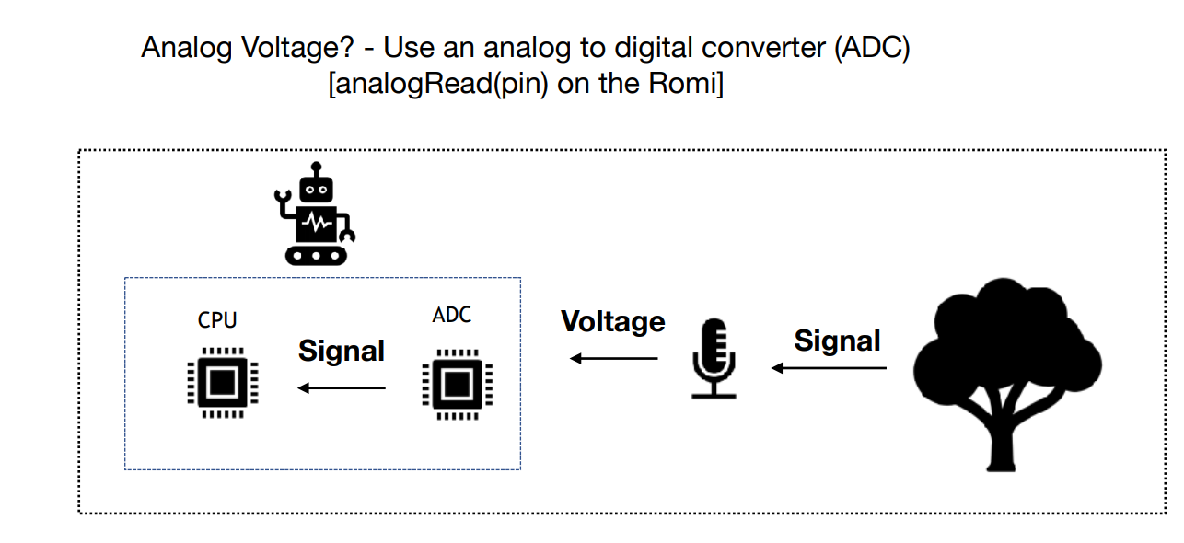
Sensing

Slide 23
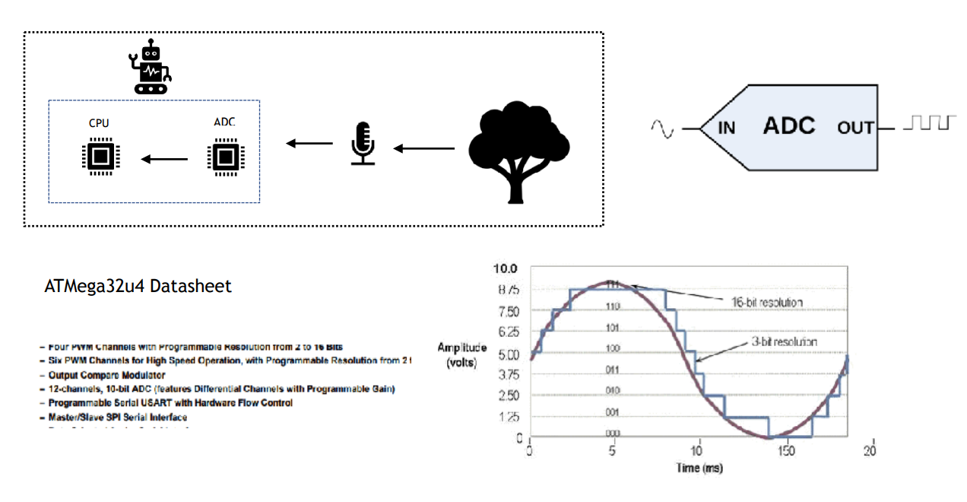
Sensing

Slide 24
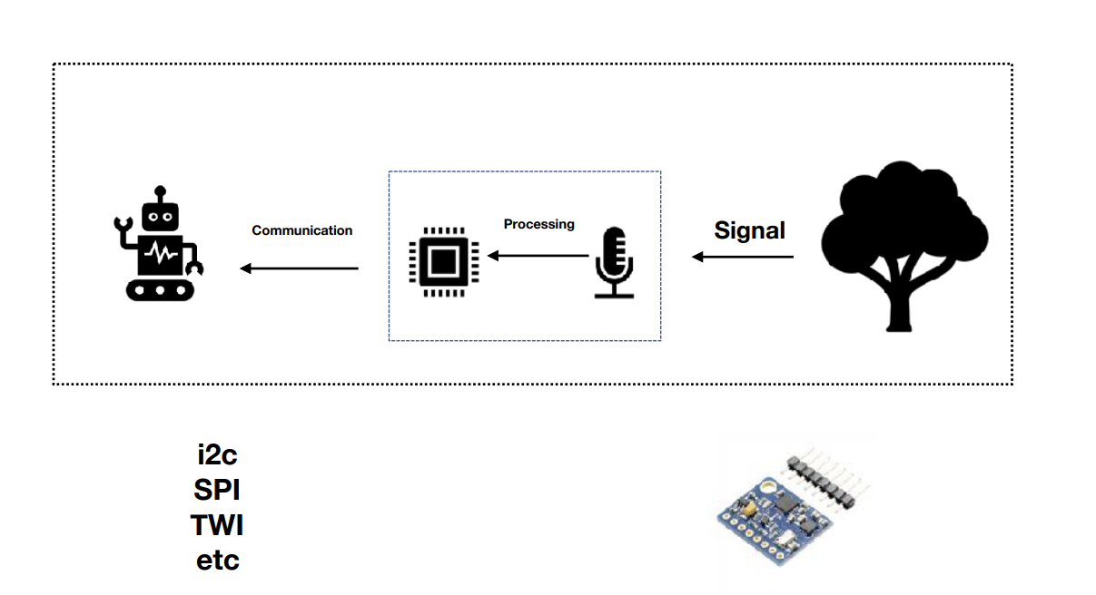
Sensing

Slide 25
Sensors and Actuators
Lecture Outline
Actuators
What actuators does the Romi have?
How do I control the motors on the Romi?
Sensors
How do I talk to a sensor?
Filtering and Calibration

Slide 26
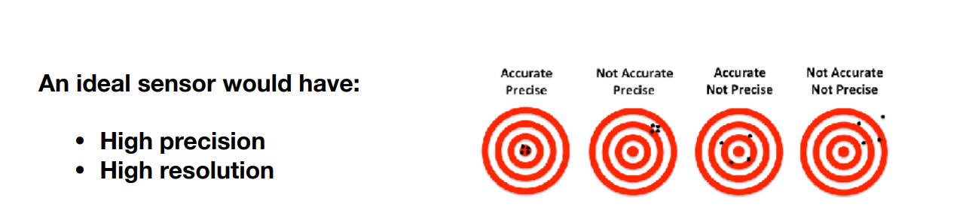
Sensing

Slide 27
Sensing
Two main types of error:
Systematic
Random

Slide 28
Sensing
Two main types of error:
Systematic → Calibrate
Random → Filter

Slide 29
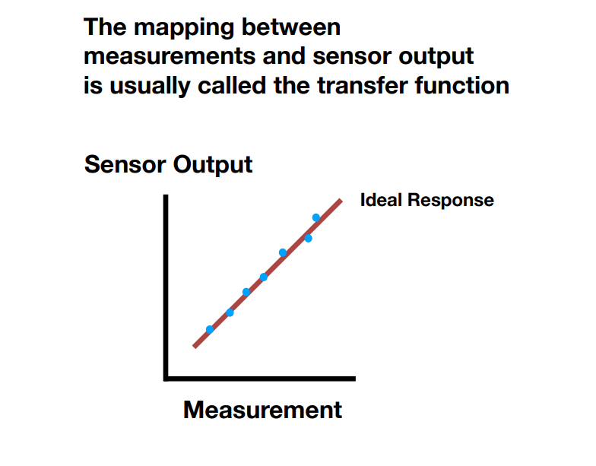
Sensing

Slide 30
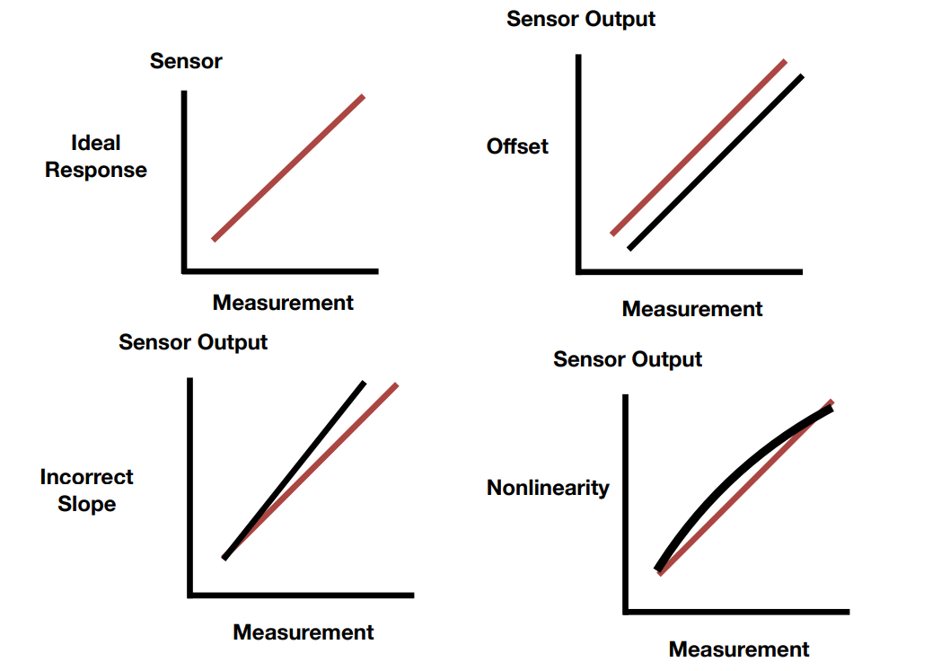
Sensing

Slide 31
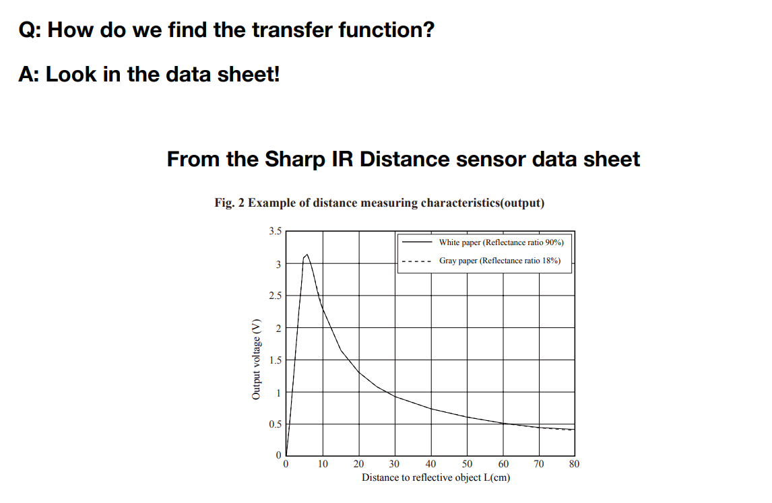
Sensing

Slide 32
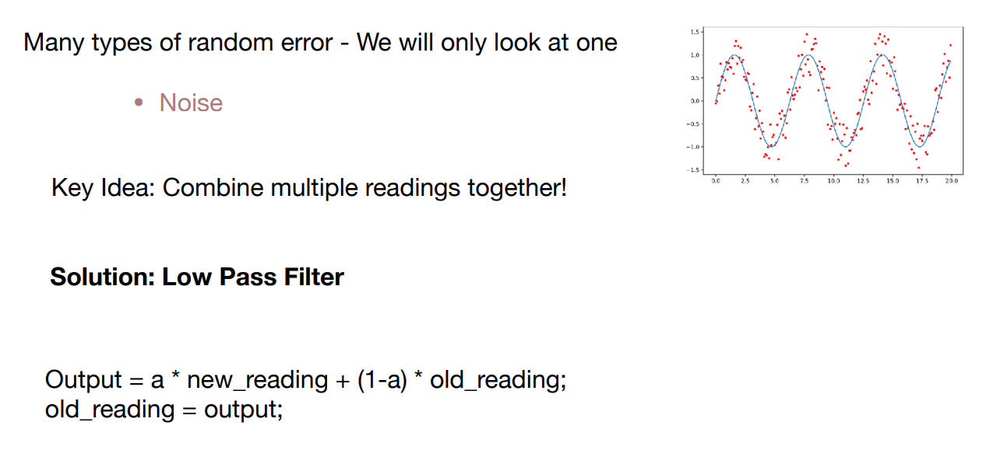
Sensing

Slide 33
Sensing
Two main types of error:
Systematic → Calibrate
Random → Filter

Slide 34
Sensing
Two main types of error:
Systematic → Calibrate
Random → Filter
BUT….
In mobile robotic systems, our sensors change location.
This means that systematic errors appear and disappear as we move.

Slide 35
Sensing
Two main types of error:
Systematic → Calibrate
Random → Filter
BUT….
In mobile robotic systems, our sensors change location.
This means that systematic errors appear and disappear as we move.
Solutions?
Sensor Fusion
Uncertainty modelling

Slide 36
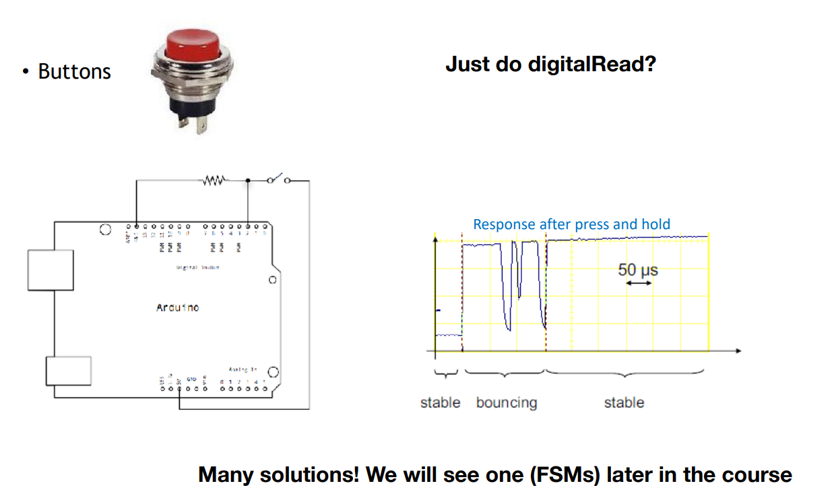
Sensing

Slide 37
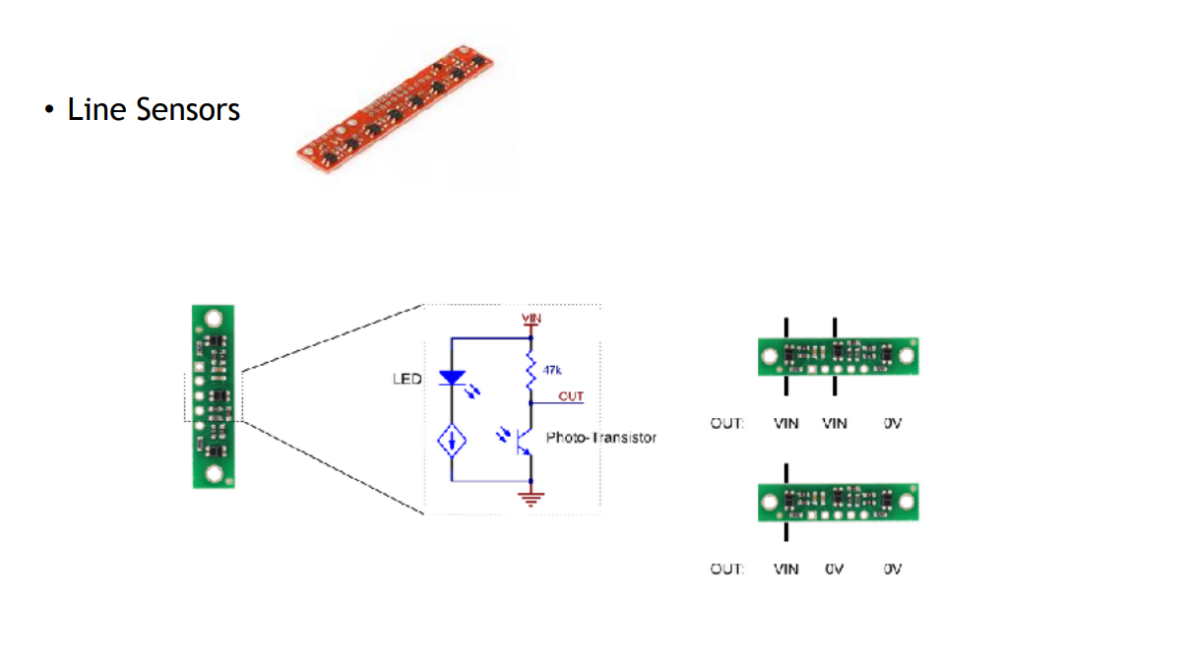
Sensing

Slide 38
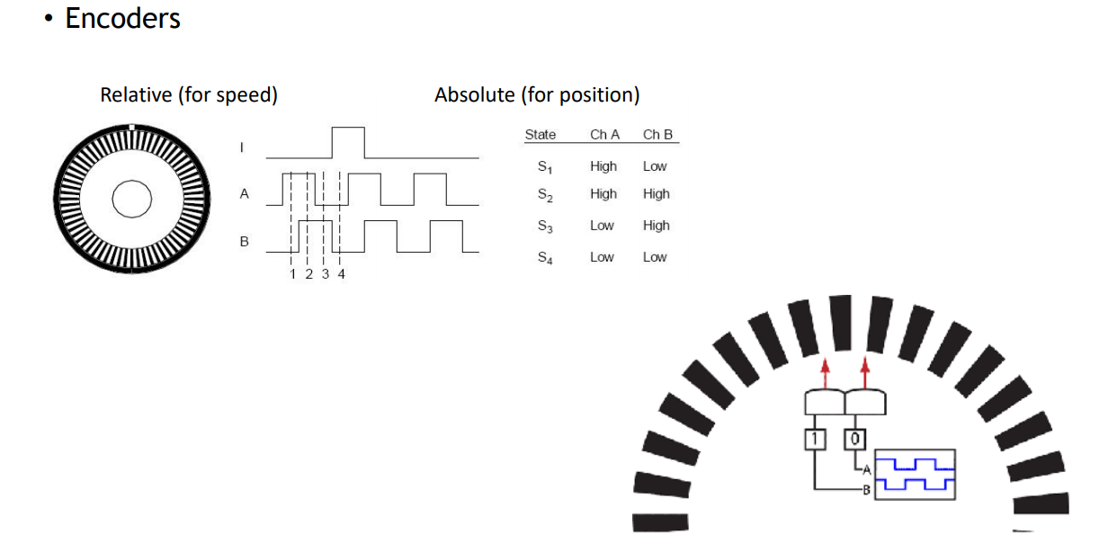
Sensing

Slide 39
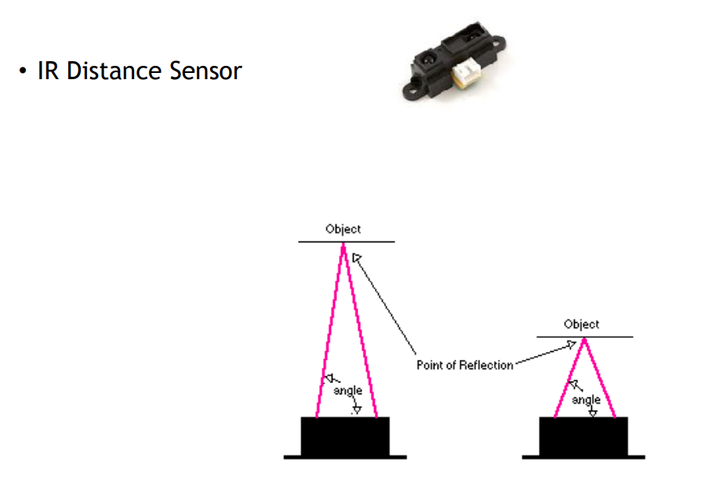
Sensors

